Slide 1

Online Banking System
R. Sri Kannan – 43110705

Slide 2
AGENDA
Abstract
Introduction
Scope of the project
Objectives
Module implementation
Architecture diagram
Conclusion

Slide 3
ABSTRACT
The Online Banking System provides a secure and efficient way for users to manage their bank accounts digitally.It allows users to register, log in, view balances, transfer money, deposit funds, and track transactions through a web interface.The system integrates frontend (React + Redux), backend (Java Spring Boot), and database (MySQL) to deliver a full-stack web application.The project demonstrates concepts of RESTful API design, data persistence, and user authentication (JWT tokens).

Slide 4
EXISTING SYSTEM
Traditional banking involves manual transactions or limited mobile features.
Customers must visit branches for deposits or transfers.
Lack of real-time visibility for balances or transaction history.
Manual data handling increases chances of errors and delays.
Limited accessibility outside working hours.

Slide 5
PROPOSED SYSTEM
A web-based digital banking platform for 24×7 access.
Users can perform:
Account registration and login
View account balances and transaction history
Deposit and transfer funds between accounts
Backend automatically validates and updates records in MySQL.
Provides secure authentication, role-based access, and real-time transaction updates.

Slide 6
ADVANTAGES
Accessible from anywhere using browser
Secure login using JWT tokens
Real-time transaction updates.
Data stored safely in MySQL database.
Easy to integrate with future modules (e.g., loan, card management).
User-friendly UI using React and Material-UI

Slide 7
DISADVANTAGES
Requires stable internet connection
Backend must be hosted continuously for access
Database maintenance and security configuration needed
Limited offline functionality

Slide 8
Processor: Intel Core i5 or above.
RAM: Minimum of 8 GB for efficient processing.
Hard Disk: 256 GB SSD or higher for faster read/write operations.
Display: Full HD (1080p) resolution for better visualization.
Internet Connection: Stable broadband required for testing and deployment.
Peripherals: Standard keyboard, mouse, and monitor setup for development use.
HARDWARE REQUIREMENTS

Slide 9
SOFTWARE REQUIREMENTS
Operating System: Windows, macOS, or Linux (any modern version).
Programming Language: Java 17 for backend development.
Frontend Technologies: HTML, CSS, JavaScript, and Font Awesome for UI design.
Build Tool: Apache Maven for project build and dependency management.
IDE (Integrated Development Environment): IntelliJ IDEA or Eclipse for coding and debugging.
Optional Tools: Node.js for managing frontend build tools or extensions.

Slide 10
MODULE
User Authentication Module
2. Account Management Module
3. Transaction Management Module
4. Payment Module
5. Database & Repository Module
6. Frontend User Interface Module

Slide 11
MODULE DESCRIPTION
Module DescriptionUser Authentication Handles registration, login, and session management using JWT.Account ManagementManages account details, balance retrieval, and updates.Transaction Management Allows fund transfer and deposit operations via REST endpoints (/transact/deposit, /transact/transfer)
.Payment Module Handles payment requests and logs them into the database.Database Module Uses JPA repositories to perform CRUD operations on MySQL tables.Frontend UI React + Redux app for user interaction with dashboard, transfer, and transaction pages.

Slide 12
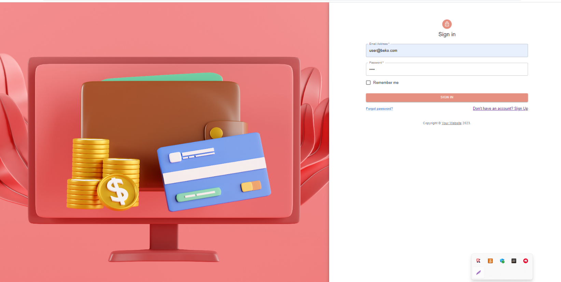
SCREENSHOTS
Fig. Login Page

Slide 13
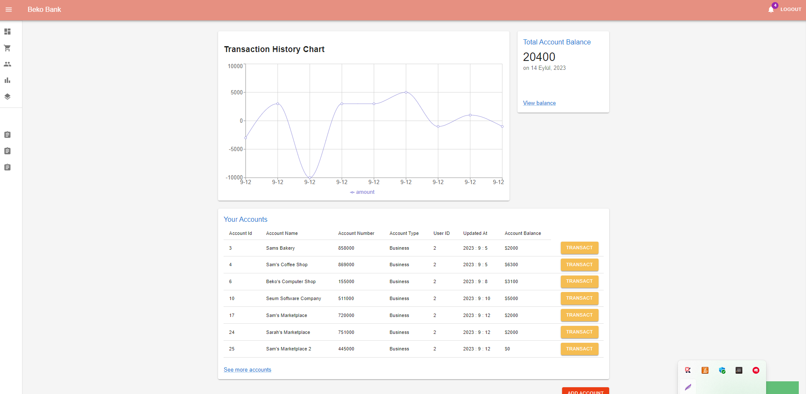
Fig. Transaction Page
SCREENSHOTS

Slide 14
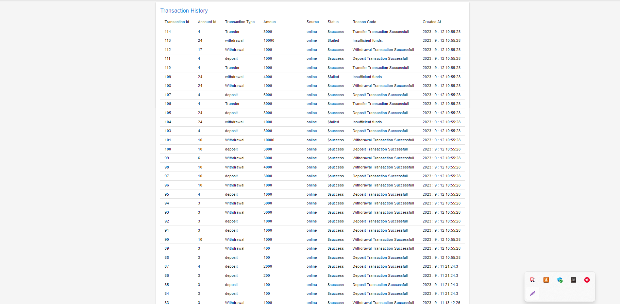
SCREENSHOTS
Fig. Transaction list Page

Slide 15
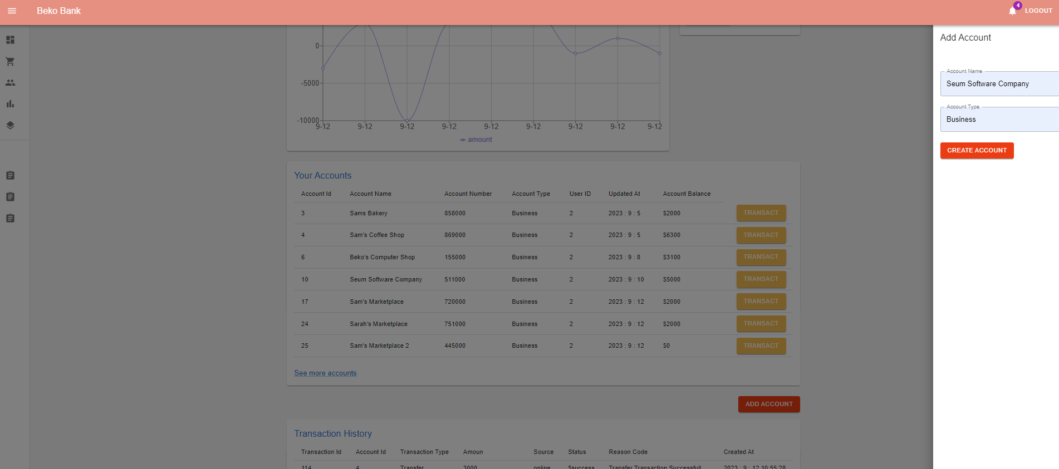
SCREENSHOTS
Fig. Analysis Page

Slide 16
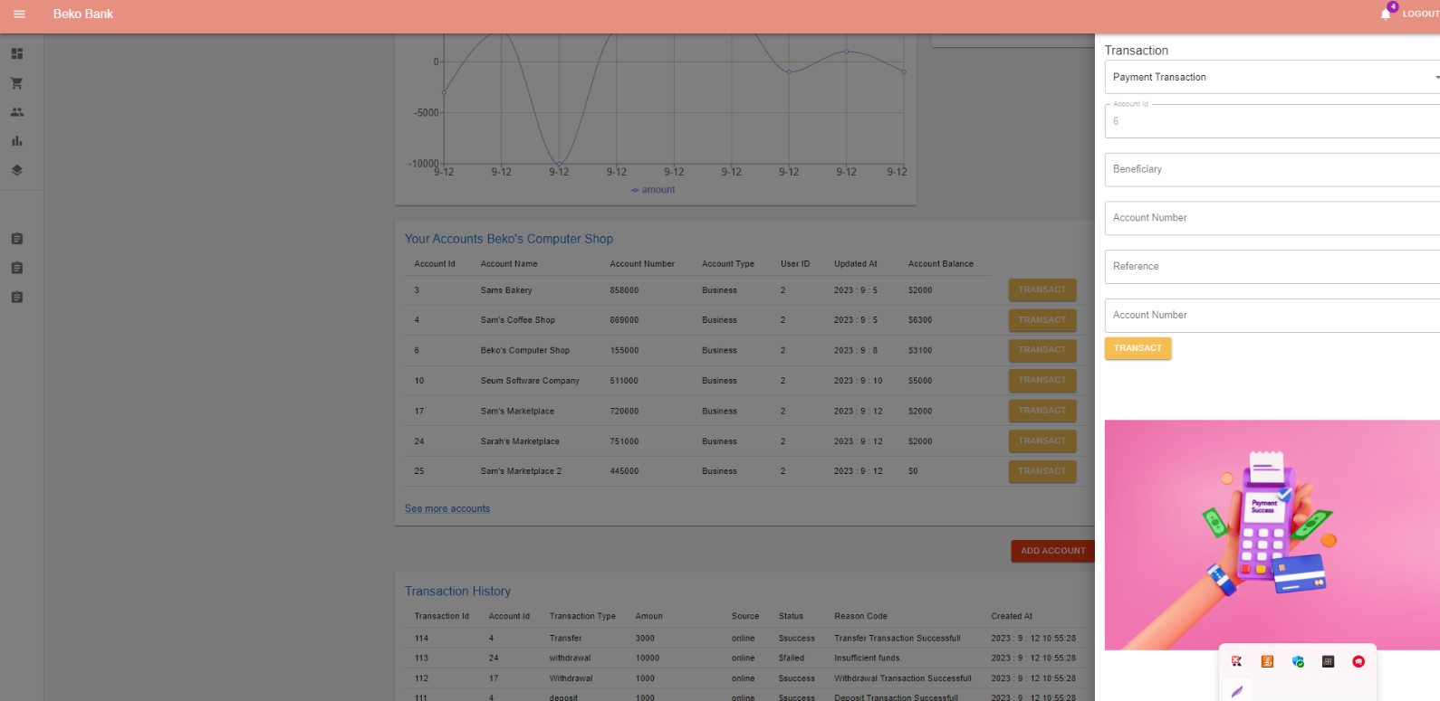
SCREENSHOTS
Fig. project Page

Slide 17
Conclusion
The Online Banking System successfully demonstrates how full-stack technologies can be used to automate real-time banking operations.
It improves speed, accuracy, and user convenience compared to manual banking systems.
The system ensures data security, scalability, and easy future expansion.
It serves as a good foundation for further enhancements such as loan services, notification systems, or AI-based fraud detection.

